Slide 1
MilLion song Dataset
Mateusz Biedak
Artur Szydek

Slide 2
Introduction
The goal of this project was to analyze a big set of songs with many parameters and then split them into clusters. In one cluster should be songs that are similar to each other or which are from the same genre.
Some of parameters were multi-dimensional arrays, so they were hard to use in comparing songs due to lack of expertise in music topic.
For example :
- segments pitches
- segments timbre
- bars start
So we used only parameters of primitive types.

Slide 3
USED parameters
Title
Year
Song hotness
Danceability
Duration
Loudness
End of fade in
Start of fade out
Key
Energy
Mode
Tempo
Time signature
Artist familiarity
Artist hotness
Artist latitude
Artist location
Artist longitude

Slide 4
Metrics
Our metrics was just a sum of all parameters normalized to [0,1] section with a proper weights. Weights for each parameter were determined empirically also using logic to establish which of them have bigger influence than the others on being similar.
Turns out that the biggest influence have:
Tempo
Key
Danceability
Loudness
Energy

Slide 5
Metrics
Additionally we used 3 more information. Information about artists similarity, information about albums and information about author.
If both songs were from the same artist, they were pretty much probable to be similar so we were decreasings metrics to simulate bigger similarity.
If songs were from the same album, they were highly probable to be similar so we were decreasing metrics a little more than in the same author case.
If songs had similar artists to each other, probability of being similar was smaller but still we had to decrease metrics a bit.

Slide 6
Example of similarity
Example for song „The Deceived” of „Trivium”:
Similar songs to The Deceived:
Upon The Shores [Explicit] : 0.359087952842
Into The Mouth Of Hell We March [Explicit] : 1.02065124741
Shogun [with fade_ for special edition] : 1.92227848439
Left For Dead (Album Version) : 1.98802889926
Machine Gun Majesty [Live] (Album Version) : 2.8512859075
Deviate From The Form : 3.06450021763
Destroy Everything (Album Version) : 3.09556197587
The End Of The Line : 3.32597617058
What You Deserve (Album Version) : 3.34492292365
The Three-Dimensional Shadow : 3.39567549181

Slide 7
As The Sleeper Awakes : 3.46313889679
Abstracted : 3.85426739036
All I Ask For (Album Version) : 4.27974976412
What Drives The Weak : 4.36703126273
One the road (to Damnation) : 4.40915014987
Shadows That Move : 4.64840753644
Origins And Endings : 4.94068676776
Sensory Deprivation Adventure : 5.25727570416
Into Battle : 5.3308877274
IV : 5.40413725782

Slide 8
Clusters
Method of clustering was pretty simple, we were choosing first song of a set and compering it with all the others with our metrics. Those which had the difference smaller than some parameter eastablished earlier, were put to the same cluster with the first song. And that was happening until set of songs was empty.
If threshold for putting into clusters was too big, clusters were very big and songs in one cluster didn’t have to be similar.
So now when threshold is good, we have a lot of clusters but with pretty similar songs, usually in one cluster all songs are from the same artist or from very similar artistto this one.

Slide 9
Example CLusters
Killed By Love, Pursuit Of Happiness
She's So Young, Pursuit Of Happiness
Hard To Laugh, Pursuit Of Happiness
Standing Knee Deep In a River (Dying Of Thirst), Kathy Mattea
Down On Him, Pursuit Of Happiness
Elle Voulait Jouer Cabaret, Patricia Kaas
One Night Alone, Vixen
Good Girl Gone Bad, Rihanna
We Ride, Rihanna
Relax, 2-4 Grooves feat. Reki D.
SOS, Rihanna
Wake The Sleeper, Uriah Heep
Music Of The Sun, Rihanna
Loba, Shakira
Don't Stop The Music, Rihanna
Good Girl Gone Bad, Rihanna
I Know Somethin (Bout You), Alice In Chains
Brother, Alice In Chains
God Smack, Alice In Chains
Sickman, Alice In Chains
Naked In The Rain (Album Version), Red Hot Chili Peppers
Take Her Out, Alice In Chains

Slide 10
Conclusions
Our metrics is working pretty good looking on those results, because usually songs of the same artist are in one cluster. Also in one cluster can be songs from similar artist but it’s not that common. Sometimes it happenes that one artist can be found in few different clusters with different artists. We wanted to examine that, so we picked few artists of different genres of music to count in how many clusters they are.
It turns out that rock and heavy metal artists picked by us are usually in one cluster, while pop artists appear to be in few.

Slide 11
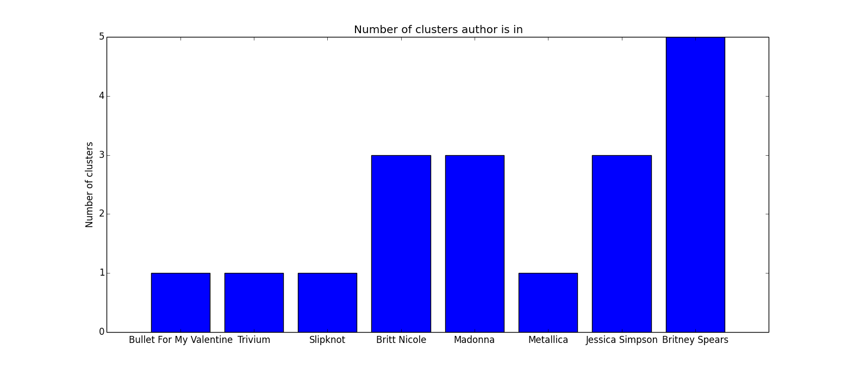
Conclusions

Slide 12
Conclusions
Our conclusions are that:
Rock and heavy metal artists are more specific and unique than pop artists, so they can be recognized easier while guessing pop artist can cause problems
Pop artists tend to steal someone else’s melodies more than artists from other genres.

